Slide 1
Module 4
Convolutional Neural Network (CNN)

Slide 2
Introduction, Convolution Neural Network
Evolution of Convolution Neural Network
CNN layers, Architecture of CNN
Evaluation of CNN Models
Types of CNN
Convolution Operation

Slide 3
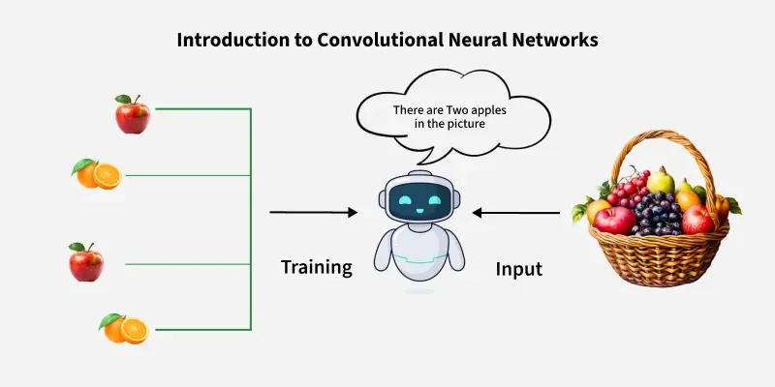
Introduction
“CNN are deep learning models designed to process data with a grid-like topology such as images”.
This is particularly useful for visual datasets such as images or videos, where data patterns play a crucial role.
They are the foundation for most modern computer vision applications to detect features within visual data.

Slide 4
Evolution of Convolution Neural Network
The evolution of Convolutional Neural Networks (CNNs) began with early concepts like the Neocognitron in the 1980s and was formalized by LeNet in 1998 for handwritten digit recognition.
A major turning point was AlexNet's victory in the 2012 ImageNet challenge, which showcased the power of deep CNNs and sparked a new wave of development, leading to deeper and more complex architectures like VGGNet, GoogLeNet, and ResNet.
These advancements focused on tackling challenges like vanishing gradients and computational cost to improve accuracy and efficiency.

Slide 5
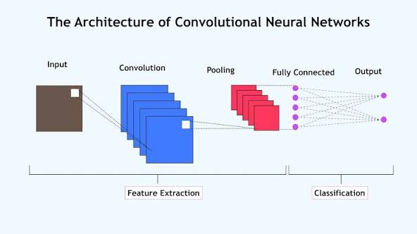
CNN Layers and Architecture of CNN
Input Layers
Convolutional Layers
Activation Layer
Pooling layer
Fully Connected Layers
Output Layer

Slide 6
Input Layers :
  It’s the layer in which we give input to our model. In CNN, Generally, the input will be an image or a sequence of images.
  This layer holds the raw input of the image with width, height, and depth.
Convolutional Layers:
  This is the layer, which is used to extract the feature from the input dataset.
  It is named after the mathematical operation called convolution called as CONVNET.
  It has set of Filters called Kernels or Masks.
  These filters are convolved with input to give feature map.
  The filters/kernels are smaller matrices usually 2x2, 3x3, or 5x5 shape.
  It slides over the input image data and computes the dot product between kernel weight and the corresponding input image patch.
  The output of this layer is referred as feature maps.

Slide 7
Activation Layer:
  By adding an activation function to the output of the preceding layer, activation layers add nonlinearity to the network.
  it will apply an element-wise activation function to the output of the convolution layer.
  Some common activation functions are RELU: max(0, x), Tanh, Leaky RELU, etc.
Pooling Layer:
  This layer is periodically inserted in the covnets and its main function is to reduce the size of volume which makes the computation fast reduces memory and also prevents overfitting.
  Two common types of pooling layers are max pooling and average pooling.

Slide 8
Fully Connected Layers: It takes the input from the previous layer and computes the final classification or regression task.
Output Layer: The output from the fully connected layers is then fed into a logistic function for classification tasks like sigmoid or softmax which converts the output of each class into the probability score of each class.

Slide 9
Convolutional Layer :
Convolutional Layer apply convolution operation to the input data which involves a filter (or kernel) that slides over the input data, performing element-wise multiplications and summing the results to produce a feature map.

Slide 10
Key Components of a Convolution Layer
1. Filters(Kernels):
  Small matrices that extract specific features from the input.
  For example, one filter might detect horizontal edges while another detects vertical edges.
  The values of filters are learned and updated during training.
2. Stride:
  Refers to the step size with which the filter moves across the input data.
  Larger strides result in smaller output feature maps and faster computation.
3. Padding:
  Zeros or other values may be added around the input to control the spatial dimensions of the output.

Slide 11
4. Activation Function:
After convolution, a non-linear function like ReLU (Rectified Linear Unit) is often applied allowing the network to learn complex relationships in data.

Slide 12
Pooling Layer :
Pooling layer is used in CNNs to reduce the spatial dimensions (width and height) of the input feature maps while retaining the most important information.
Types of Pooling Layers
1. Max Pooling
  Max pooling selects the maximum element from the region of the feature map covered by the filter.
  Thus, the output after max-pooling layer would be a feature map containing the most prominent features of the previous feature map.
  Max pooling layer preserves the most important features (edges, textures, etc.) and provides better performance in most cases.

Slide 13
2. Average Pooling
Average pooling computes the average of the elements present in the region of feature map covered by the filter.
Thus, while max pooling gives the most prominent feature in a particular patch of the feature map, average pooling gives the average of features present in a patch.
Average pooling provides a more generalized representation of the input.
It is useful in the cases where preserving the overall context is important.

Slide 14
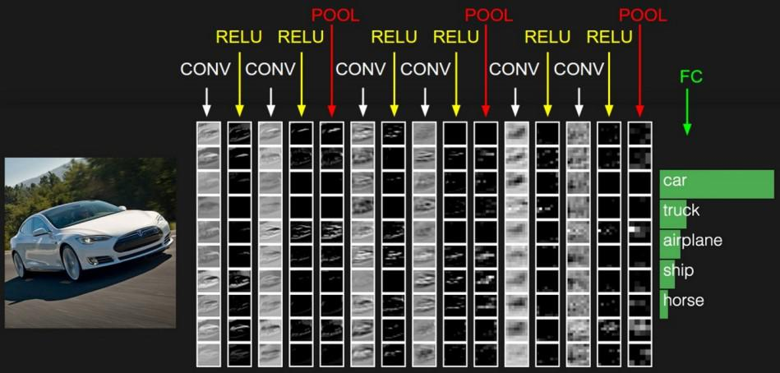

Slide 15
Applications
Image classification: CNNs are the state-of-the-art models for image classification. They can be used to classify images into different categories such as cats and dogs.
Object detection: It can be used to detect objects in images such as people, cars and buildings. They can also be used to localize objects in images which means that they can identify the location of an object in an image.
Image segmentation: It can be used to segment images which means that they can identify and label different objects in an image. This is useful for applications such as medical imaging and robotics.
Video analysis: It can be used to analyze videos such as tracking objects in a video or detecting events in a video. This is useful for applications such as video surveillance and traffic monitoring.

Slide 16
Advantages
  High Accuracy: They can achieve high accuracy in various image recognition tasks.
  Efficiency: They are efficient, especially when implemented on GPUs.
  Robustness: They are robust to noise and variations in input data.
  Adaptability: It can be adapted to different tasks by modifying their architecture.
Disadvantages
  Complexity: It can be complex and difficult to train, especially for large datasets.
  Resource-Intensive: It require significant computational resources for training and deployment.
  Data Requirements: They need large amounts of labeled data for training.
  Interpretability: They can be difficult to interpret making it challenging to understand their predictions.

Slide 17
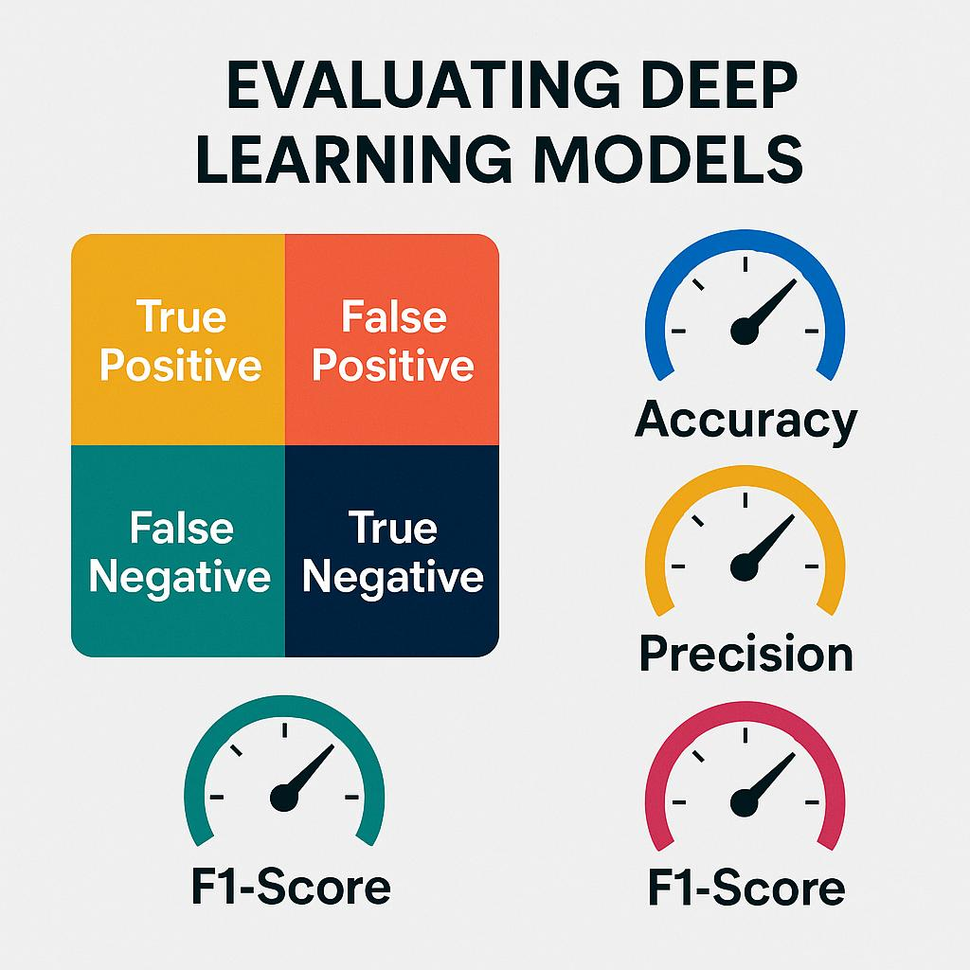
Evaluation of CNN Models

Slide 18
A confusion matrix is a performance evaluation table used to assess how well a classification model (like a CNN) performs on a set of test data where the true labels are known
Term | Meaning | Example (Cat vs Not Cat)
TP (True Positive) | Model predicts Cat, and it’s actually Cat. | Correctly detected a cat.
TN (True Negative) | Model predicts Not Cat, and it’s actually Not Cat. | Correctly rejected a non-cat.
FP (False Positive) | Model predicts Cat, but it’s actually Not Cat. | Mistakenly said there’s a cat.
FN (False Negative) | Model predicts Not Cat, but it’s actually Cat. | Missed a real cat.

Slide 19
Accuracy: Accuracy is the percentage of test images that the CNN correctly classifies.
Accuracy = (TP + TN) / Total
Precision: Precision is the percentage of test images that the CNN predicts as a particular class and that are actually of that class.
Precision = TP / (TP + FP)

Slide 20
Recall: Recall is the percentage of test images that are of a particular class and that the CNN predicts as that class.
Recall = TP / (TP + FN)
F1 Score: The F1 Score is a harmonic mean of precision and recall. It is a good metric for evaluating the performance of a CNN on classes that are imbalanced.
F1 = 2 × (Precision × Recall) / (Precision + Recall)

Slide 21
Problem Statement :A trained CNN model to classify images as Cat (positive class) or Not-Cat (negative class). On a test set of 200 images the model produced the following outcomes:
True Positives (TP) = 80 (model predicted Cat, actual Cat)
True Negatives (TN) = 90 (model predicted Not-Cat, actual Not-Cat)
False Positives (FP) = 20 (model predicted Cat, actual Not-Cat)
False Negatives (FN) = 10 (model predicted Not-Cat, actual Cat)
Confusion matrix is:
 | Predicted Cat | Predicted Not-Cat
Actual Cat | TP = 80 | FN = 10
Actual Not-Cat | FP = 20 | TN = 90

Slide 22
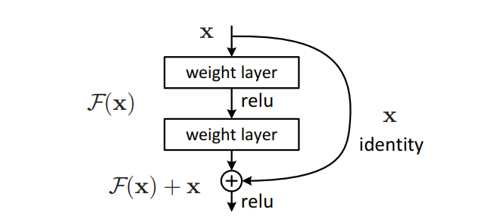
Residual Networks (ResNet) - Deep Learning
ResNet, which was proposed in 2015 by researchers at Microsoft Research introduced a new architecture called Residual Network.
In order to solve the problem of the vanishing/exploding gradient, this architecture introduced the concept called Residual Blocks. In this network, we use a technique called skip connections.

Slide 23
The skip connection connects activations of a layer to further layers by skipping some layers in between.
This forms a residual block.
Resnets are made by stacking these residual blocks together.
The approach behind this network is instead of layers learning the underlying mapping, we allow the network to fit the residual mapping. So, instead of say H(x), initial mapping, let the network fit,
F(x) = H(x) - x is the "residual", which is usually smaller and easier to learn
The network combines this residual F(x) with the input x using a shortcut or skip connection: which gives H(x) = F(x) + x.

Slide 24
The advantage of adding this type of skip connection is that if any layer hurt the performance of architecture then it will be skipped by regularization.
So, this results in training a very deep neural network without the problems caused by vanishing/exploding gradient.
Learning small adjustments F(x) is much easier for the network, especially when the network is very deep. This makes training faster and avoids problems like gradients becoming too small

Slide 25
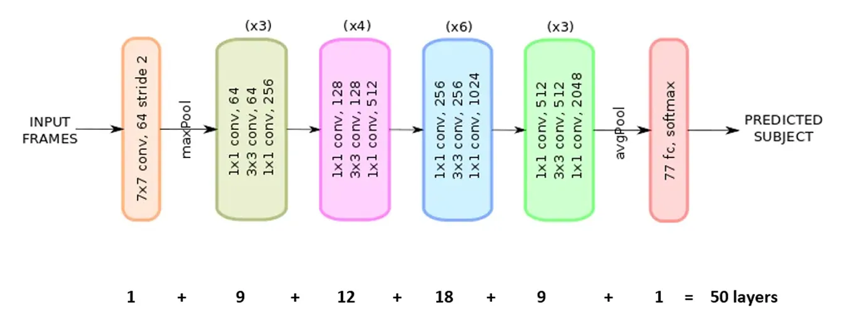
Architecture of RESNET50

Slide 26
Key Features
Depth: The network consists of 50 layers, including 48 convolutional layers, one average pooling layer, and one fully connected layer.
Residual Blocks: The core innovation is the "residual block" (also called a "bottleneck block"), where the output of an earlier layer is added to the output of a later layer. This creates a direct path for the gradient to flow during backpropagation, mitigating the vanishing gradient problem.
Skip Connections: These identity connections allow the original input information to bypass one or more layers, ensuring that the network can maintain performance even with increased depth. The output of a residual block is represented as \(f(x)+x\), where \(x\) is the input and \(f(x)\) is the learned residual mapping.

Slide 27
Pre-training: ResNet-50 is typically available pre-trained on the ImageNet database, a massive dataset with millions of images across 1000 object categories. This pre-training provides strong, general feature representations that can be applied to new tasks through transfer learning.
Architecture: The network is divided into five main stages, with each stage containing multiple residual blocks and employing batch normalization and ReLU activation functions

Slide 28
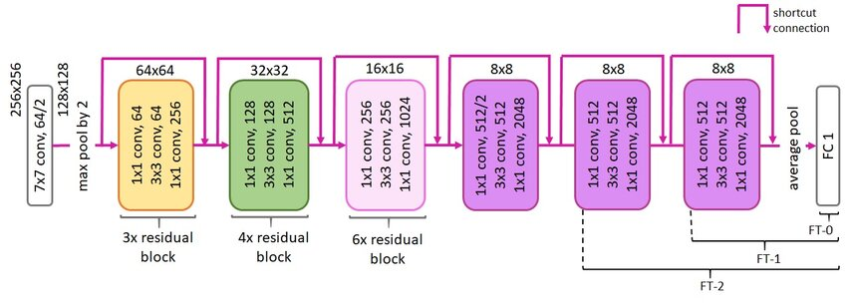

Slide 29
VGG-16 | CNN model
The VGG-16 model is a convolutional neural network (CNN) architecture that was proposed by the Visual Geometry Group (VGG) at the University of Oxford.
It is characterized by its depth, consisting of 16 layers including 13 convolutional layers and 3 fully connected layers.
VGG-16 is renowned for its simplicity and effectiveness as well as its ability to achieve strong performance on various computer vision tasks including image classification and object recognition.
Despite its simplicity compared to more recent architectures it remains a popular choice for many deep learning applications due to its versatility and excellent performance.

Slide 30
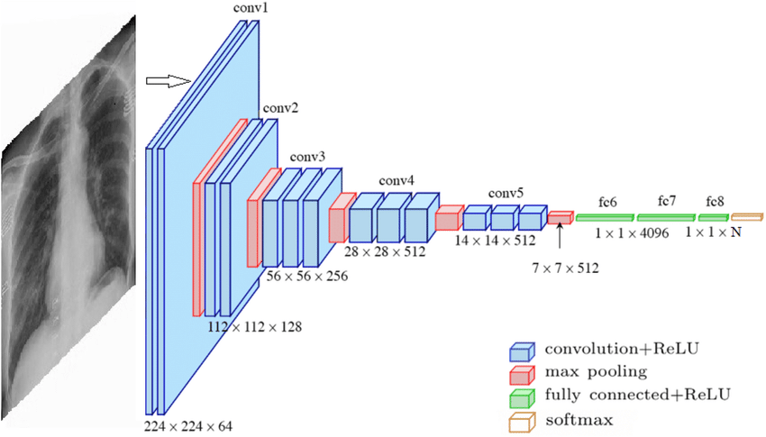
VGG-16 Architecture

Slide 31
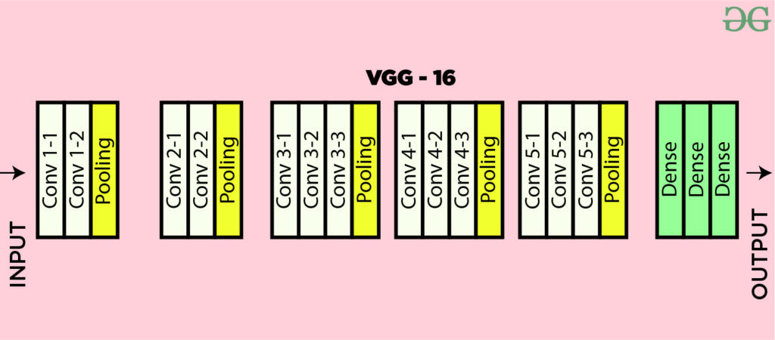

Slide 32
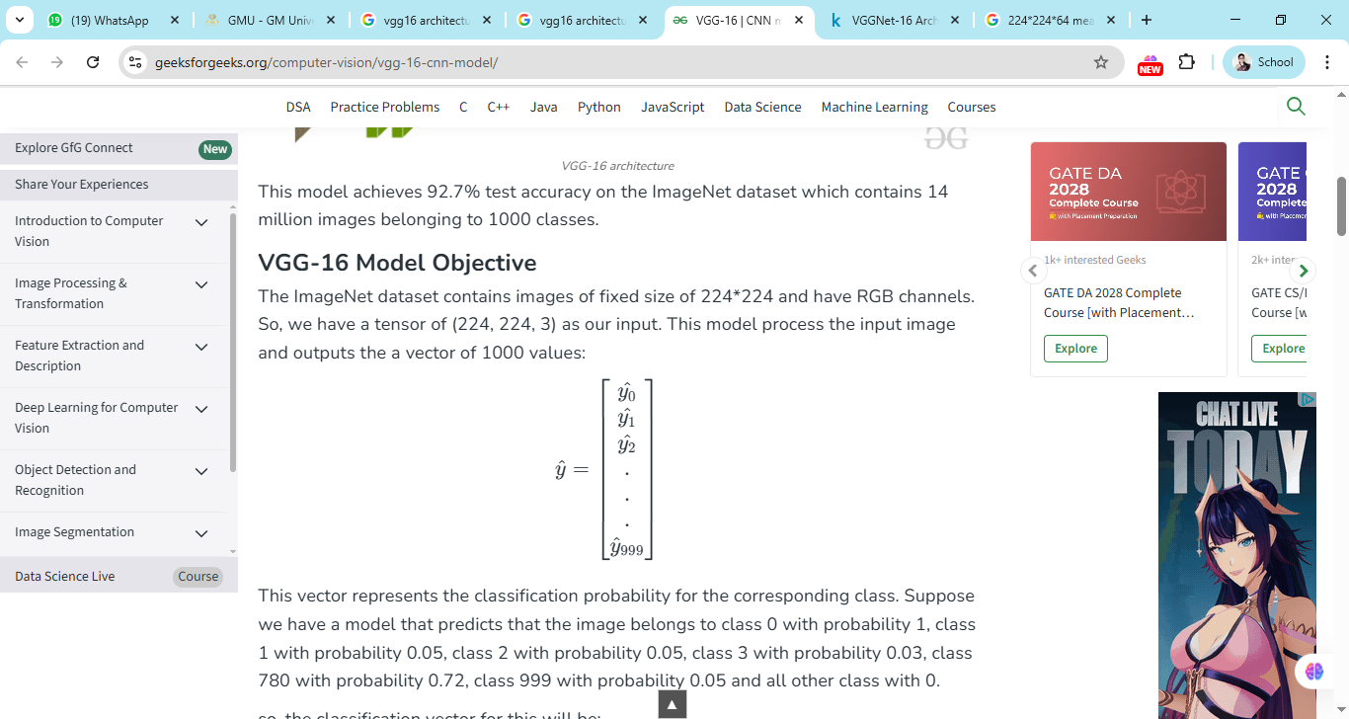
The ImageNet dataset contains images of fixed size of 224*224 and have RGB channels. So, we have a tensor of (224, 224, 3) as our input.
This model process the input image and outputs the a vector of 1000 values:
It typically consists of 16 layers, including 13 convolutional layers and 3 fully connected layers.
These layers are organized into blocks, with each block containing multiple convolutional layers followed by a max-pooling layer for downsampling.

Slide 33
1. Input Layer:
  Input dimensions: (224, 224, 3)
2. Convolutional Layers (64 filters, 3x3 filters, same padding, Stride 1):
  Two consecutive convolutional layers with 64 filters each and a filter size of 3x3.
  Same padding is applied to maintain spatial dimensions.
3. Max Pooling Layer (2x2, stride 2):
  Max-pooling layer with a pool size of 2x2 and a stride of 2.
4. Convolutional Layers (128 filters, 3x3 filters, same padding ,Stride 1):
  Two consecutive convolutional layers with 128 filters each and a filter size of 3x3.
5. Max Pooling Layer (2x2, stride 2):
  Max-pooling layer with a pool size of 2x2 and a stride of 2.

Slide 34
6. Convolutional Layers (256 filters, 3x3 filters, same padding, Stride 1):
  Two consecutive convolutional layers with 256 filters each and a filter size of 3x3.
7. Convolutional Layers (512 filters, 3x3 filters, same padding, Stride 1):
  Two sets of three consecutive convolutional layers with 512 filters each and a filter size of 3x3.
8. Max Pooling Layer (2x2, stride 2):
  Max-pooling layer with a pool size of 2x2 and a stride of 2.
9. Stack of Convolutional Layers and Max Pooling:
  Two additional convolutional layers after the previous stack.
  Filter size: 3x3.
10. Flattening:
  Flatten the output feature map (7x7x512) into a vector of size 25088.
11. Fully Connected Layers:
  Three fully connected layers with ReLU activation.

Slide 35
